Slide 1
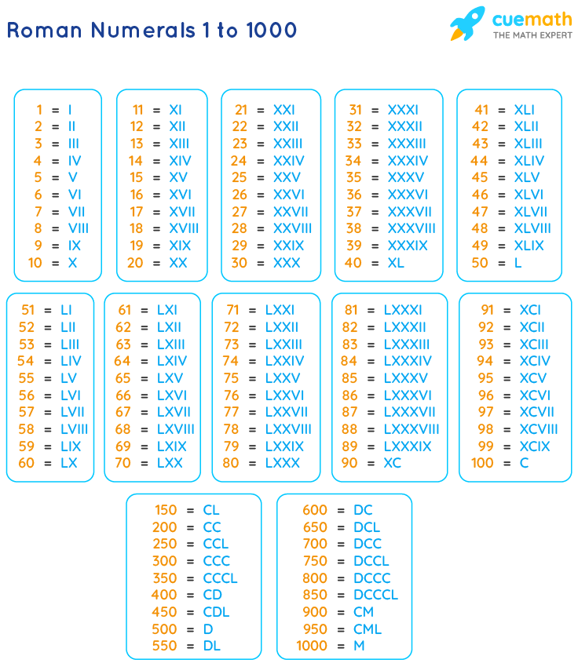
C PROGRAM TO CONVERT INTEGERS TO ITS ROMAN NUMERAL
ABSTARCT:-
THIS PROGRAM IS TO CONVERT INTEGERS < 5000 TO ITS CORRESPONDING ROMAN NUMERAL VALUE.
CORRESPONDING() METHOD:-
I HAVE USED CORRESPONDING() METHOD TO FIND WHETHER THE INPUT INTEGER IS NEARER TO THE NUMERALS HAVING SYMBOL .
EXAMPLE:900 IS NEARER TO 1000 SO WE WILL DEFINE IT AS CM,WHERE C IS 100 AND M IS 1000 .IT IS SIMILAR TO THAT FOR 9 , IX IS THE NUMERAL WHERE I IS 1 AND X IS 10.
GITHUB LINK IS AVAILABLE IN POST DESCRIPTION

Slide 2
C PROGRAM TO CONVERT INTEGERS TO ITS ROMAN NUMERAL
ROMAN_IDENTIFIER() METHOD:
I USED ROMAN_ITENDTIFIER() FUNCTION TO GET THE INPUT AND SHOW THE OUTPUT BY USING THE LOGICS I HAVE IDENTIFIED.
MAIN() METHOD:
THE WORK OF MAIN FUNCTION IS TO READ THE INPUT AND SEND IT TO THE ROMAN_IDENTIFIER METHOD.
GITHUB LINK IS AVAILABLE IN POST DESCRIPTION

